Slide 1
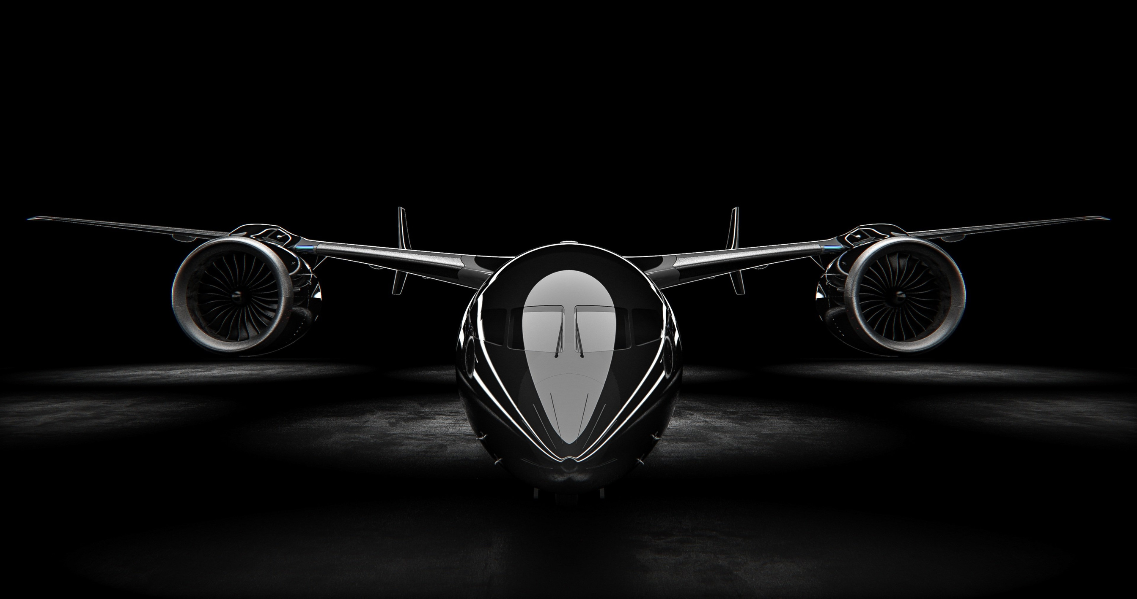


DESIGN OF GEOMINER 1 :
A HYBRID VTOL UAV FOR INTELLIGENT MINERAL EXPLORATION AND MINING OPERATIONS
PROJECT PROPOSAL — GROUP FOUR
UAV SYSTEMS ENGINEERING
INSA Talent Center · Department of Aerospace
August 2026 · Addis Ababa, Ethiopia
Team Members:
  Abdulfetah AymEN BENARD DUBIWAK EDEN
  HIYAB RAFIK YAQOB ZEKI
SCOPE
A PROFESSIONAL HYBRID VTOL UAV SYSTEM ENGINEERED FOR MINERAL EXPLORATION, geological mappiNG, MINE-SITE SURVEYING, AND HIGH-RESOLUTION AERIAL DATA COLLECTION IN REMOTE AND HAZARDOUS ENVIRONMENTS.

Slide 2
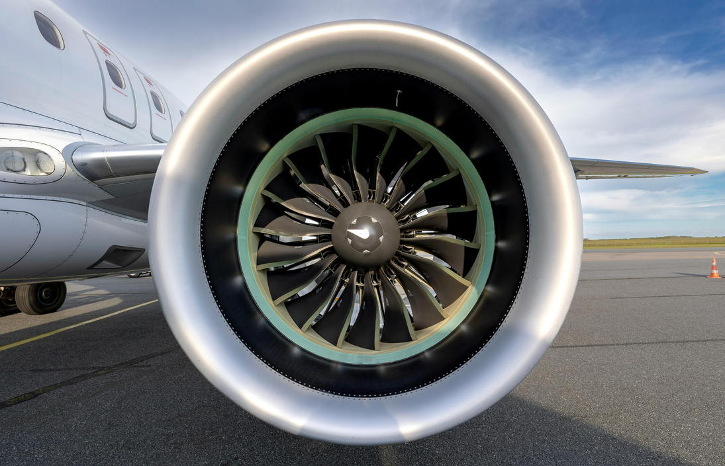
WHY IS THIS UAV NEEDED?
UNDERSTANDING THE REASON
GEOMINER 1 SOLUTION
VTOL flexibility + fixed-wing efficiency + modular sensing + autonomous navigation
This enables rapid deployment and extended aerial surveying while reducing unnecessary personnel exposure to hazardous terrain.
Why a Hybrid VTOL UAV?
A purpose-built Hybrid VTOL UAV overcomes these limitations by providing autonomous aerial surveying with minimal human intervention.
✓ No Runway Required
  Vertical takeoff and landing from virtually any flat surface.
✓ Zero Personnel Exposure
  Remote autonomous operation keeps personnel away from hazardous environments.
✓ Rapid Deployment
  Fast mission setup and shorter survey cycles, reducing operational time and cost.
✓ High-Precision Data Collection
  Captures accurate geospatial, geological, and environmental data for better decision-making.
✓ Long-Endurance Operations
  Combines VTOL flexibility with fixed-wing efficiency for extended-range mining missions.
Operational Challenges
1. INACCESSIBLE TERRAIN
  Remote mining areas and rugged terrain make conventional ground surveys difficult and time-consuming.
2. HAZARDOUS ENVIRONMENTS
  Mining sites can expose personnel to unstable ground, dust, toxic gases, water, and other operational hazards.
3. SURVEYING COST & TIME
  Conventional surveying requires significant personnel, equipment, and operational time.
4. UAV CAPABILITY GAP
  Multirotors provide VTOL capability but have limited endurance, while fixed-wing aircraft require suitable launch and recovery areas.

Slide 3

PROJECT OBJECTIVE
DESIGN A FEASIBLE, MODULAR HYBRID VTOL UAV
Develop and evaluate a 30 kg hybrid VTOL UAV capable of vertical takeoff and landing, efficient fixed-wing cruise, high-precision navigation, modular sensing, autonomous mission execution, and safe operation in remote mining environments.
CORE OBJECTIVES
  Establish complete system requirements.
  Develop the conceptual airframe.
  Design the VTOL and cruise propulsion systems.
  Design the avionics and electrical architecture.
  Integrate the Pixhawk autopilot.
  Configure ArduPilot QuadPlane flight control.
  Use QGroundControl as the Ground Control Station (GCS).
  Develop a modular payload system.
  Perform aerodynamic and conceptual design analysis.
  Evaluate the design through engineering simulation.
  Analyze safety, redundancy, and reliability.
  Select components using engineering justification.
ENGINEERING DESIGN WORKFLOW
FROM REQUIREMENTS TO UAV CONFIGURATION
MISSION REQUIREMENTS
↓
SYSTEM REQUIREMENTS
↓
CONCEPTUAL CONFIGURATION
↓
Onshape CAD DEVELOPMENT
↓
OpenVSP AIRCRAFT MODELING
↓
XFLR5 AERODYNAMIC ANALYSIS
↓
PROPULSION & POWER SIZING
↓
AVIONICS & PIXHAWK INTEGRATION
↓
ARDUPILOT QUADPLANE CONFIGURATION
↓
QGROUNDCONTROL GCS CONFIGURATION
↓
SYSTEM INTEGRATION
↓
PERFORMANCE & SAFETY EVALUATION

Slide 4
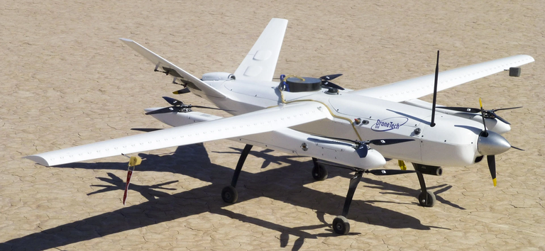
SYSTEM REQUIREMENTS
COMPLETE SYSTEM REQUIREMENT SET
The proposed GEOMINER establishes these performance targets, including the 30 kg MTOW, 120-minute endurance, 100 km mission range, 5 kg payload and 2.8 m wingspan.
Category | Requirement / Target
Configuration | Hybrid VTOL fixed-wing
MTOW | 30 kg
Payload | Up to 5 kg
Endurance | 120 min
Mission range | 100 km
Wingspan | 2.8 m
Category | Requirement / Target
Cruise speed | 18–25 m/s
Maximum speed | 30 m/s
Hover T/W | ≥1.8
RTK accuracy | <5 cm horizontal
Service ceiling | 4,000 m ASL
Flight controller | Pixhawk
Category | Requirement / Target
Autopilot | ArduPilot QuadPlane
GCS | QGroundControl
Payload interface | Mechanical + power + data
Recovery | VTOL landing + emergency recovery
Mission operation | Autonomous with operator supervision

Slide 5
DESIGN TOOLS & SOFTWARE
ENGINEERING DESIGN & SIMULATION WORKFLOW
CONCEPTUAL DESIGN
Onshape
Purpose:
  3D CAD modeling
  Airframe design
  Component arrangement
  Structural layout
  Assembly development
  Design collaboration
INTELLIGENT MODULAR AERIAL MINING SYSTEM
KEY DESIGN FEATURES
1. HYBRID VTOL FLIGHT
Four lift motors provide vertical takeoff, landing, and hovering.
2. FIXED-WING CRUISE
A dedicated rear pusher motor provides efficient forward flight.
3. PRECISION NAVIGATION
RTK-GNSS, IMU, magnetometer, barometer, and airspeed sensing support navigation.
4. MODULAR PAYLOAD BAY
Quick-release interfaces allow different sensors to be installed for different missions.
5. ONBOARD COMPUTING
A companion computer provides data processing and future AI capability.
6. PIXHAWK FLIGHT CONTROL
Pixhawk serves as the primary flight-control platform running ArduPilot QuadPlane.
7. QGROUNDCONTROL GCS
QGroundControl provides mission planning, monitoring, configuration, and operator supervision.
XFLR5
Purpose:
  Wing and airfoil analysis
  Lift and drag estimation
  Aerodynamic performance evaluation
  Stability and performance assessment
QGroundControl
Purpose:
  Mission planning
  Parameter configuration
  Telemetry monitoring
  Ground-control interface
  Operator supervision
SolidWorks
Purpose:
  Detailed 3D CAD modeling
  Part and assembly design
  Airframe and component development
  Structural design and validation
  Engineering drawings
  CFD and flow simulations
  Aerodynamic and fluid-flow analysis
  Design optimization and performance evaluation
ArduPilot / QuadPlane
Purpose:
  Hybrid VTOL flight-control architecture
  VTOL and fixed-wing flight modes
  Autonomous mission logic
  Navigation and failsafe configuration
Pixhawk
Purpose:
  Primary flight-control hardware
  Sensor integration
  Navigation
  Actuator control
  Flight-state management

Slide 6
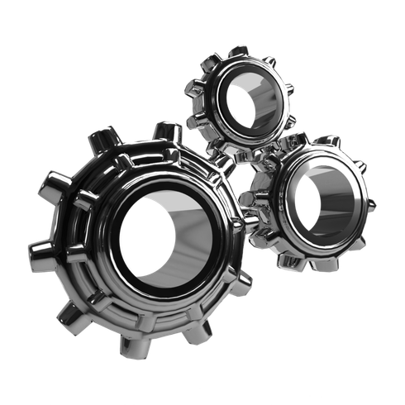
OVERALL SYSTEM ARCHITECTURE
4. ELECTRICAL POWER SYSTEM
  Main battery
  Backup battery
  BMS
  PDB
  Wiring and protection
Functions: Power supply, management, protection.
SEVEN MAJOR SYSTEMS & SUBSYSTEMS
3. PROPULSION SYSTEM
  4 VTOL motors
  1 pusher motor
  ESCs
  Propellers
Functions: Lift, cruise thrust, transition.
1. STRUCTURAL SYSTEM
  Fuselage
  Wing
  Twin-boom tail
  Landing gear
  VTOL arms
  Motor mounts
Functions: Support, stability, aerodynamic performance, protection.
2. AVIONICS SYSTEM
  Pixhawk flight controller
  IMU
  RTK-GNSS
  Magnetometer
  Barometer
  Airspeed sensor
  Obstacle sensors
Functions: Stabilization, navigation, autonomy.
5. MISSION COMPUTING & COMMUNICATION
  Companion computer
  Telemetry
  Data storage
  Communication system
Functions: Mission computing, communications, data processing.
6. PAYLOAD SYSTEM
  Payload bay
  Quick-release mount
  3-axis gimbal
  Mission sensors
Functions: Sensor integration, stabilization, data collection.
7. SAFETY & EMERGENCY SYSTEM
  Ballistic parachute
  Flight-termination system
  Locator beacon
  Geofencing
Functions: Recovery, emergency response, tracking.

Slide 7
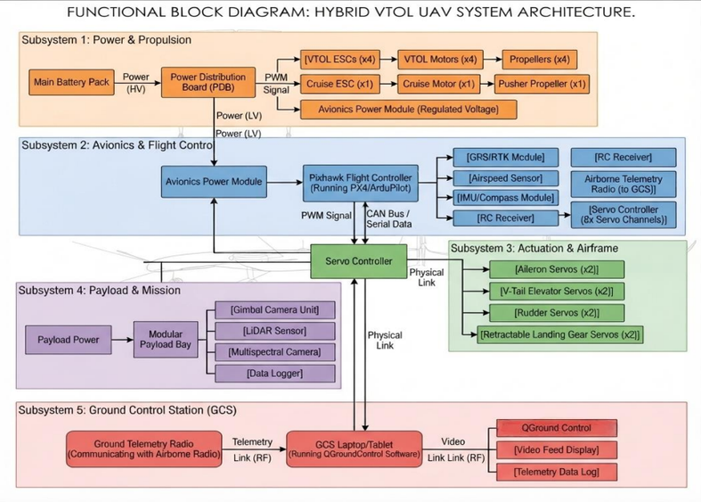
FLIGHT CONTROL & GROUND CONTROL
BLOCK DIAGRAM
PIXHAWK + ARDUPILOT + QGROUNDCONTROL
PIXHAWK AUTOPILOT
Primary flight-control functions
  Attitude stabilization
  Navigation
  Sensor integration
  Motor/servo control
  VTOL transition management
  Failsafe execution
QGROUNDCONTROL GCS
Used as the ground control station for:
  Mission planning
  Waypoint configuration
  Flight monitoring
  Parameter configuration
  Telemetry
  Operator commands
  Return-to-home supervision
ARDUPILOT QUADPLANE
Used as the autopilot software for the hybrid VTOL configuration.
Architecture:
QGroundControl GCs -- Telemetry Link -- Pixhawk -- ArduPilot QuadPlane -- Navigation / Propulsion / Payload / Safety

Slide 8
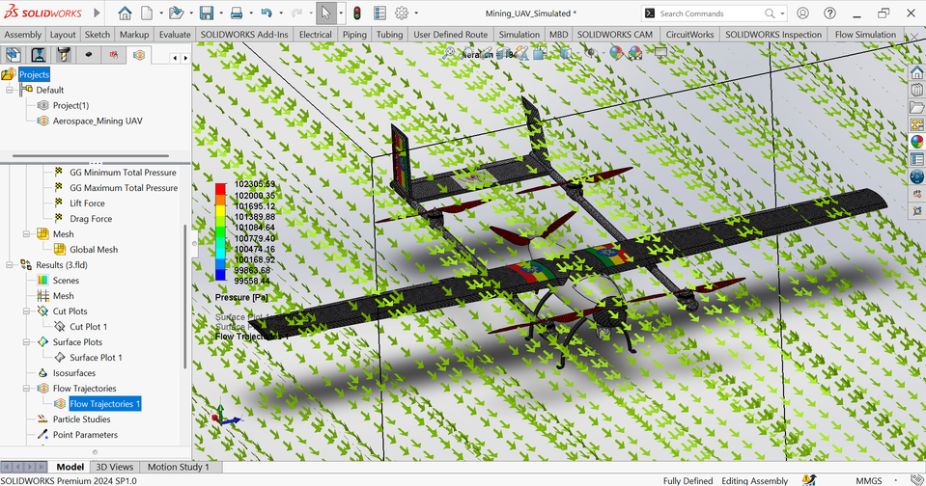
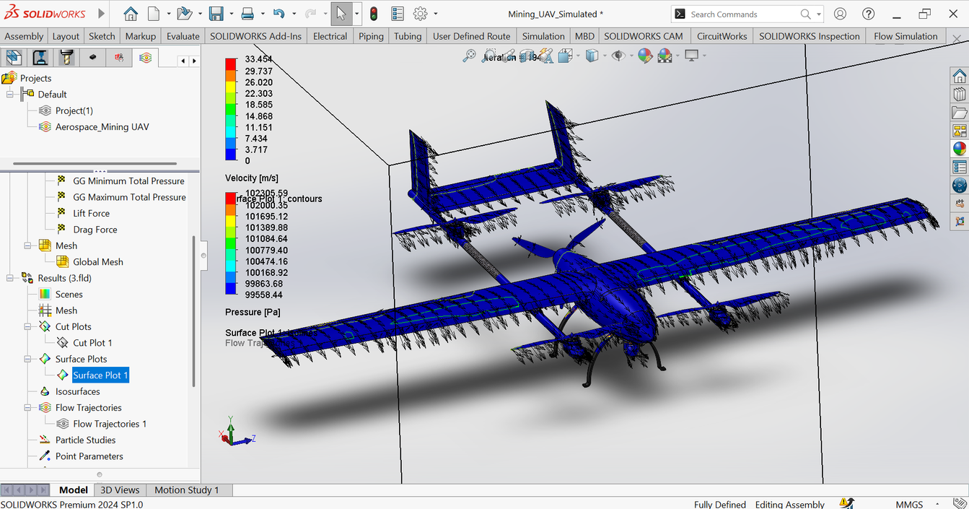
DETAILED AIRFRAME DESIGN
STRUCTURAL & AERODYNAMIC CONFIGURATION
PRIMARY STRUCTURE
  Carbon-fiber fuselage
  High-aspect-ratio fixed wing
  Twin-boom tail
  Reinforced landing system
  VTOL motor supports
DESIGN OBJECTIVES
LOW MASS
Reduce structural weight to preserve payload and battery capacity.
HIGH STIFFNESS
Maintain aerodynamic shape and flight stability.
MODULARITY
Provide accessible areas for avionics, batteries, payloads, and maintenance.
AERODYNAMIC EFFICIENCY
Optimize the aircraft for efficient fixed-wing cruise.
DESIGN SOFTWARE
Onshape → CAD / Assembly
SolidWorks → Detailed CAD / CFD & Flow Simulation
XFLR5 → Aerodynamic Analysis

Slide 9
COMPONENT SELECTION & ENGINEERING JUSTIFICATION
MAJOR COMPONENTS
Component | Selection | Engineering Justification
Flight Controller | Pixhawk | Established UAV flight-control platform
Autopilot | ArduPilot QuadPlane | Supports hybrid VTOL/fixed-wing operation
Navigation | RTK-GNSS | High-precision positioning
Structure | Carbon Fiber | High stiffness-to-weight ratio
VTOL Motors | 4 × lift motors | Redundant vertical propulsion
Component | Selection | Engineering Justification
Cruise Motor | Rear pusher | Efficient forward cruise
Battery | 14S Li-ion | High energy density
Payload | Modular bay | Supports multiple mission sensors
Safety | Parachute + FTS | Emergency recovery capability
GCS | QGroundControl | Mission planning and flight supervision

Slide 10
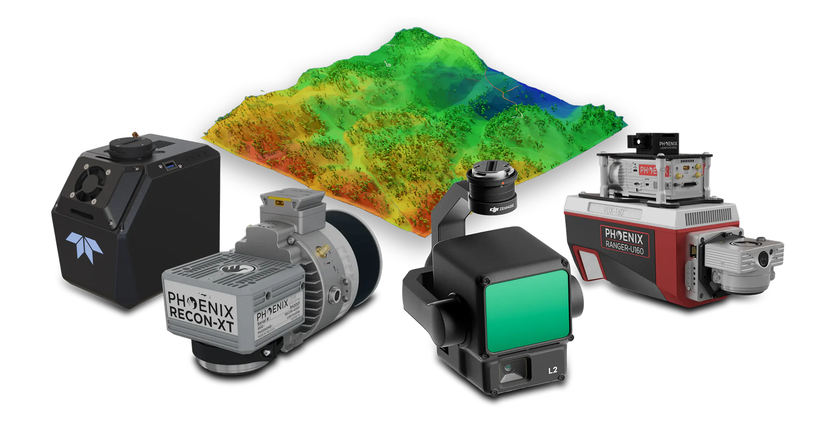
MODULAR PAYLOAD SYSTEM
ONE UAV → MULTIPLE MINING MISSIONS
AVAILABLE PAYLOADS
  Survey-grade LiDAR → 3D terrain mapping
  RGB mapping camera → Orthomosaics
  Hyperspectral camera → Mineral identification
  Multispectral camera → Vegetation/land monitoring
  Magnetometer → Magnetic anomaly detection
  Thermal camera → Thermal inspection
  Multi-gas sensor → Hazardous gas detection
  Radiation detector → Radioactive-zone surveying
Maximum modular payload: 5 kg
The original GEOMINER proposal explicitly defines eight interchangeable sensor modules and a standardized mechanical, power, and data interface.

Slide 11



SIMULATION & ANALYSIS
ENGINEERING SIMULATION ACTIVITIES
XFLR5
Completed / Used for:
  Airfoil analysis
  Wing aerodynamic analysis
  Lift/drag evaluation
  Preliminary aerodynamic performance assessment
QGroundControl
Intended for:
  Mission planning
  GCS configuration
  Flight visualization
  Autonomous mission setup
  Simulation/testing
SolidWorks
Completed / Used for:
  Detailed aircraft 3D modeling
  Wing and fuselage design
  Component and assembly development
  Structural design
  CFD and flow simulations
  Aerodynamic performance analysis
  Design validation and optimization
Simulation Status:
Required aerodynamic and fluid-flow simulations have been successfully completed in SolidWorks. The UAV design is now prepared for software-in-the-loop (SITL) flight simulation using Gazebo, with the aircraft model to be integrated through URDF and connected to QGroundControl for flight-control and mission testing.

Slide 12
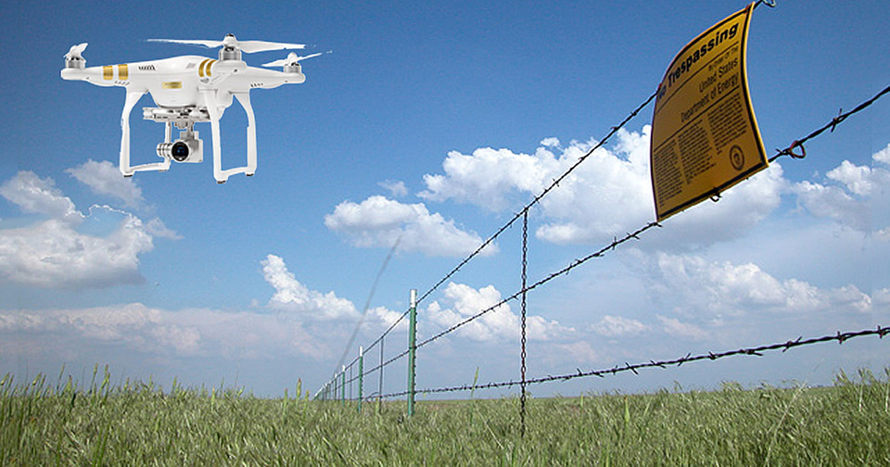
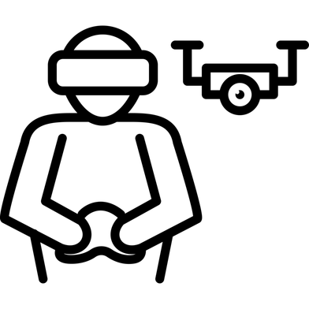
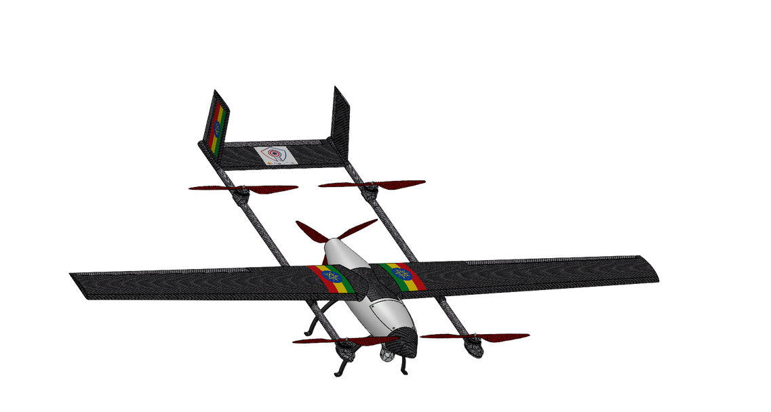
SAFETY, REDUNDANCY & MISSION RELIABILITY
LAYERED SAFETY ARCHITECTURE
FLIGHT SAFETY
  Geofencing
  Return-to-Home
  Emergency termination
SENSOR REDUNDANCY
  IMU
  GNSS
  Barometer
  Magnetometer
  Airspeed
  Range sensing
PROPULSION REDUNDANCY
  Four independent VTOL motors
  Separate cruise motor
POWER REDUNDANCY
  Main battery
  Backup power
RECOVERY
  Ballistic parachute
  Locator beacon
  Emergency water-landing capability
DATA RELIABILITY
  Onboard data recording
  Data backup
  Telemetry monitoring

Slide 13
ENGINEERING TRADE-OFF ANALYSIS
KEY DESIGN DECISIONS
Trade-Off | Selected Design | Reason
Hover vs Endurance | Hybrid VTOL | VTOL + efficient cruise
Weight vs Strength | Carbon Fiber | High strength/stiffness-to-weight
Payload vs Endurance | Modular Payload | Carry mission-specific sensors
Battery vs Weight | Li-ion | High energy density
Speed vs Mapping | Variable Cruise Speed | Match mission requirements
Cost vs Performance | Commercial Components | Balance cost and reliability
Autonomy vs Safety | Supervised Autonomy | Human oversight for critical phases

Slide 14
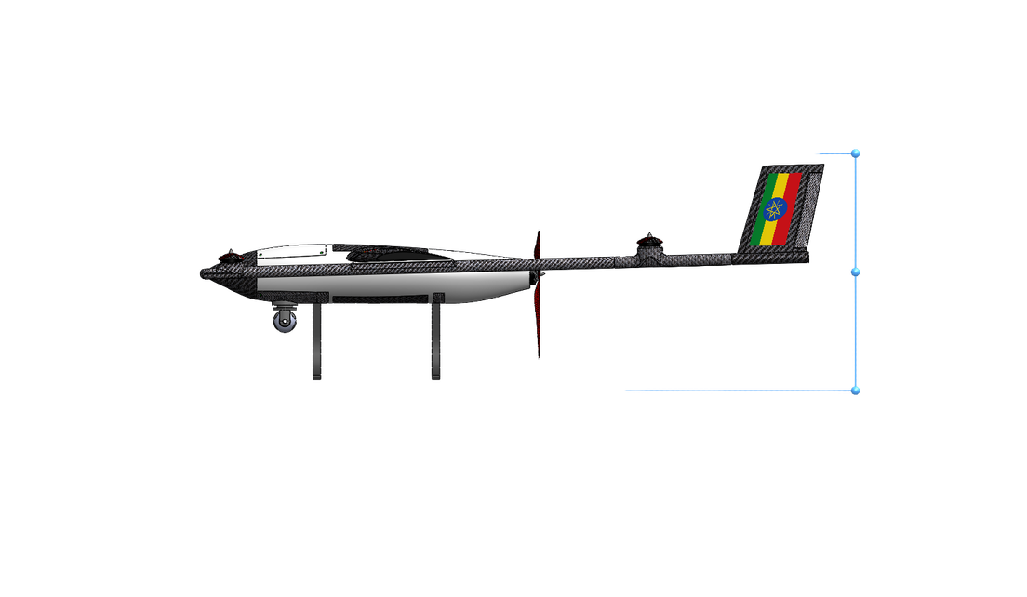
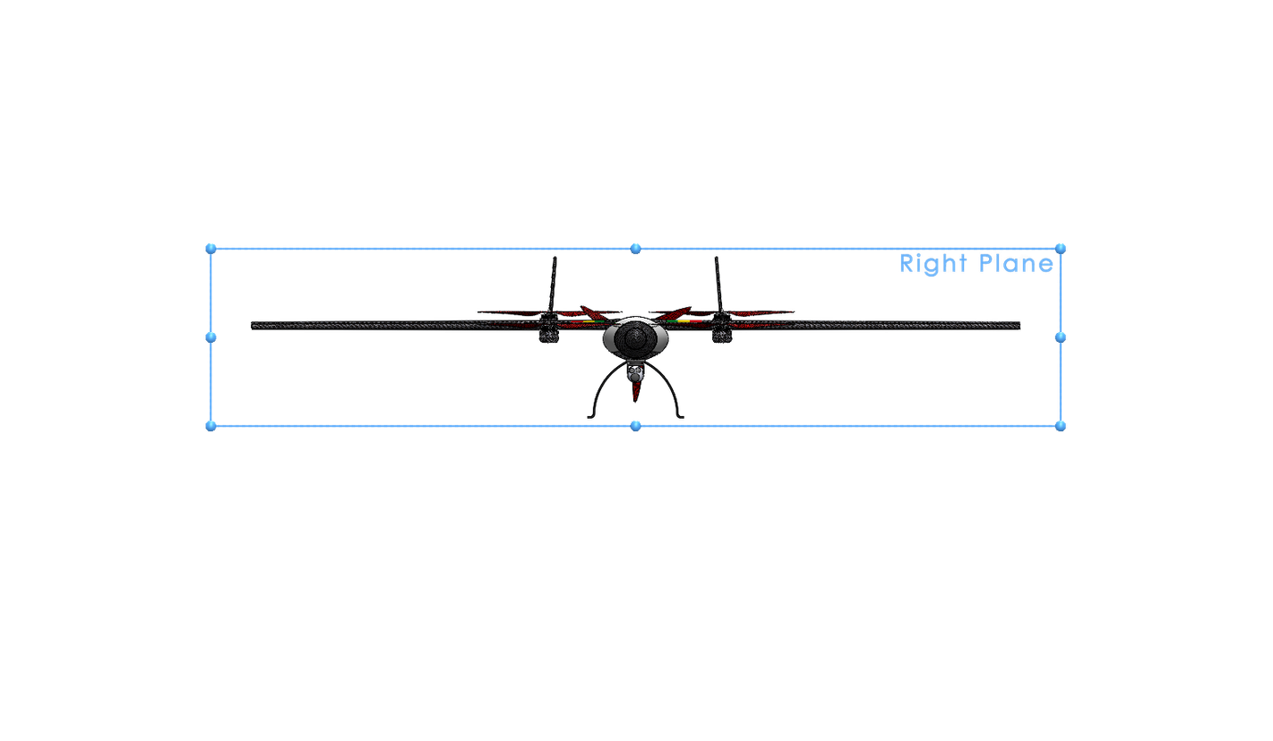
EXPECTED DELIVERABLES
PROJECT OUTPUTS
1. COMPLETE PROJECT DOCUMENTATION
✅ Full engineering report
✅ PDF documentation
✅ PowerPoint presentation
✅ Simulation and analysis results
2. SYSTEM REQUIREMENTS
✅ Mission requirements
✅ Performance requirements
✅ Component requirements
✅ Airframe requirements
✅ Avionics requirements
✅ Payload requirements
✅ Safety requirements
✅ Simulation requirements
3. DESIGN & ENGINEERING
✅ Complete hybrid VTOL configuration
✅ Airframe design
✅ Propulsion system
✅ Electrical power system
✅ Avionics architecture
✅ Payload architecture
✅ Safety architecture
4. FLIGHT CONTROL
✅ Pixhawk autopilot
✅ ArduPilot QuadPlane
✅ QGroundControl GCS architecture
✅ Mission planning concept
✅ Autonomous flight-control architecture
5. ENGINEERING SOFTWARE
✅ Onshape — CAD design
✅ OpenVSP — aircraft configuration
✅ XFLR5 — aerodynamic analysis
✅ ArduPilot — autopilot architecture
✅ QGroundControl — GCS and
mission-planning environment
6. SYSTEM ARCHITECTURE
✅ Complete system architecture
✅ Major systems and subsystems
✅ Functional block diagram
✅ Component interfaces
✅ Flight-control architecture
7. COMPONENT SELECTION
✅ Major component identification
✅ Engineering justification
✅ Weight and power considerations
✅ Performance considerations
8. SAFETY & RELIABILITY
✅ Safety analysis
✅ Redundancy strategy
✅ Failsafe architecture
✅ Emergency recovery
✅ Mission reliability considerations
9. PERFORMANCE
✅ MTOW analysis
✅ Payload capacity
✅ Endurance estimate
✅ Range estimate
✅ Propulsion sizing
✅ Aerodynamic analysis
✅ Expected operational capabilities

Slide 15
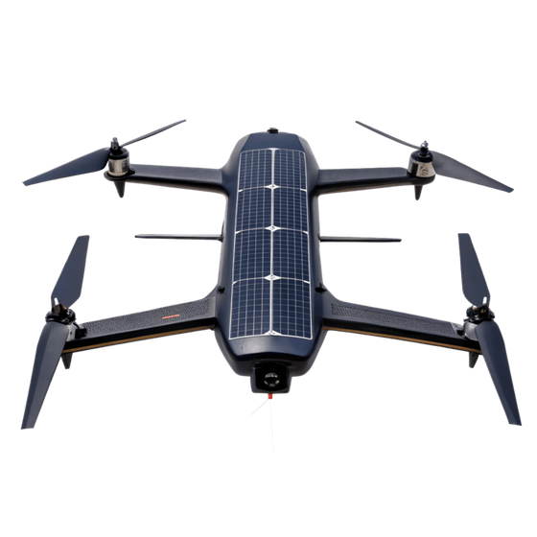

FUTURE IMPROVEMENTS & DEVELOPMENT ROADMAP
Future Improvements
  AI & ML – Onboard mineral detection and autonomous decisions
  Digital Twin – Real-time mine site modeling
  Swarm UAVs – Multi-drone coordinated missions
  Satellite Communication – Beyond-line-of-sight (BLOS) operation
  Renewable Energy – Solar-powered charging stations
  Cybersecurity – Encrypted links and GNSS protection
Development Roadmap
PHASE 1 — ENERGY
  Higher-density batteries and improved power management.
PHASE 2 — SENSING
  Advanced LiDAR, hyperspectral, thermal, and magnetic sensors.
PHASE 3 — AI
  Onboard mineral anomaly detection and intelligent data processing.
PHASE 4 — COMMUNICATION
  Satellite communications and extended-range operations.
PHASE 5 — MULTI-UAV
  Coordinated multi-UAV mapping of large mining concessions.

Slide 16
FINAL DESIGN SUMMARY
GEOMINER 1 is a professional Hybrid VTOL Mining UAV that integrates vertical takeoff and landing, efficient fixed-wing cruise, precision navigation, modular payloads, autonomous flight control, and layered safety systems for mineral exploration and mining operations.
Designed using Onshape, SolidWorks, and XFLR5, with SolidWorks used for CFD and fluid-flow simulations. Pixhawk + ArduPilot QuadPlane handles flight control, while QGroundControl provides mission planning and monitoring.
Project Status: The required aerodynamic and fluid-flow simulations have been completed in SolidWorks. The UAV is now ready for Gazebo-based SITL flight simulation, using a URDF model for integration with QGroundControl. The next stage is to validate flight dynamics, VTOL operation, transition, and autonomous control.

Slide 17
“ THANK YOU SO MUCH FOR YOUR ATENTION!!! ”

